Slide 1

Lecture with Computer Exercises: Modelling and Simulating Social Systems with MATLAB How do participants act during an apéro at ETH?
%add picture
source:kestrel-cam
Emek Barış Küçüktabak, Francesca Sabena, Emile Courthoud, Hangxi Li
Notes:
Hello,
Today me and Francesca will present the research made by HollKamp and Gordon in 1996 about the comparison between piezos and constrained layer damping.

Slide 2
List of Contents
Introduction and Motivation
Description of the Model
Implementation
Simulation Results and Discussion
Summary
Source: Pix4D
Notes:
The main objective of the research consists in explaining what was known 20 years ago about piezos,
and this is the first half of the half of the contents of the paper
and the experimental comparison with another solution that was well established, the constrained layer damping treatments
The experiment will be explained by Francesca

Slide 3
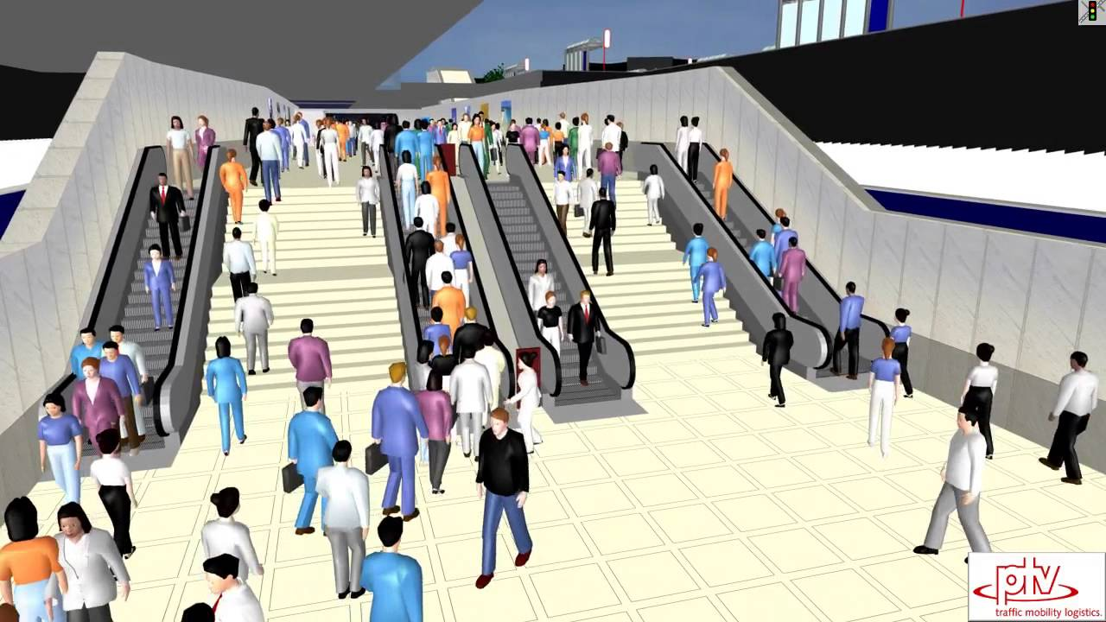
Introduction and Motivation
Pedestrian Traffic
Simulation
Source: Pix4D
https://www.youtube.com/watch?v=UUHFMtR9q9M
Notes:
The main objective of the research consists in explaining what was known 20 years ago about piezos,
and this is the first half of the half of the contents of the paper
and the experimental comparison with another solution that was well established, the constrained layer damping treatments
The experiment will be explained by Francesca

Slide 4
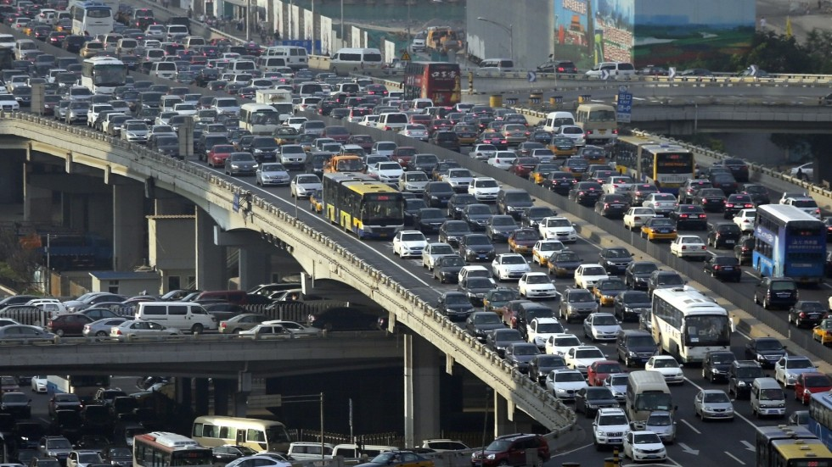
Introduction and Motivation
Car Traffic
Source: Pix4D
Notes:
The main objective of the research consists in explaining what was known 20 years ago about piezos,
and this is the first half of the half of the contents of the paper
and the experimental comparison with another solution that was well established, the constrained layer damping treatments
The experiment will be explained by Francesca

Slide 5
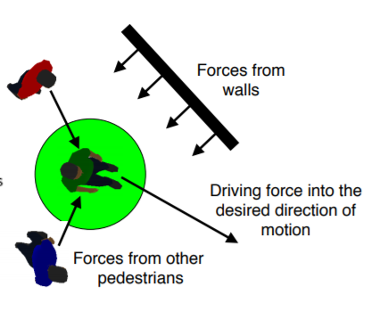
Introduction and Motivation
Social Force Model
Source: Pix4D
Notes:
The main objective of the research consists in explaining what was known 20 years ago about piezos,
and this is the first half of the half of the contents of the paper
and the experimental comparison with another solution that was well established, the constrained layer damping treatments
The experiment will be explained by Francesca

Slide 6
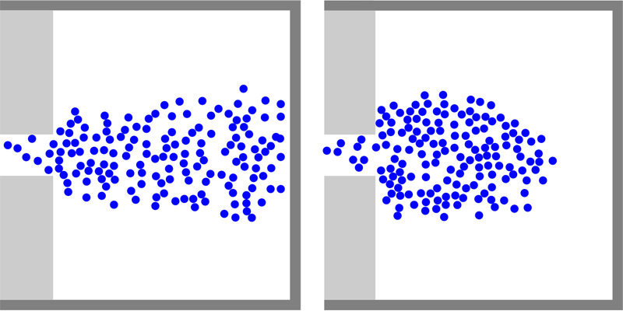
Introduction and Motivation
Source: Pix4D
SEITZ, Michael J. et al. The Superposition Principle: A Conceptual Perspective on Pedestrian Stream Simulations.Collective Dynamics, [S.l.], v. 1, p. 1-19, mar. 2016. ISSN 2366-8539. Available at: <https://collective-dynamics.eu/index.php/cod/article/view/A2>.
Notes:
The main objective of the research consists in explaining what was known 20 years ago about piezos,
and this is the first half of the half of the contents of the paper
and the experimental comparison with another solution that was well established, the constrained layer damping treatments
The experiment will be explained by Francesca

Slide 7
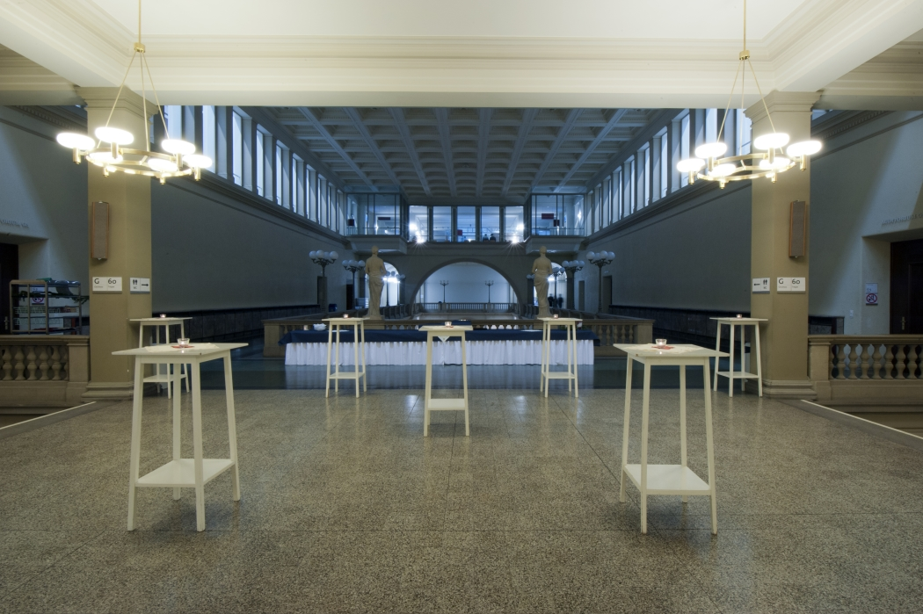
Introduction and Motivation
Apero in ETH
Source: Pix4D
Notes:
The main objective of the research consists in explaining what was known 20 years ago about piezos,
and this is the first half of the half of the contents of the paper
and the experimental comparison with another solution that was well established, the constrained layer damping treatments
The experiment will be explained by Francesca

Slide 8
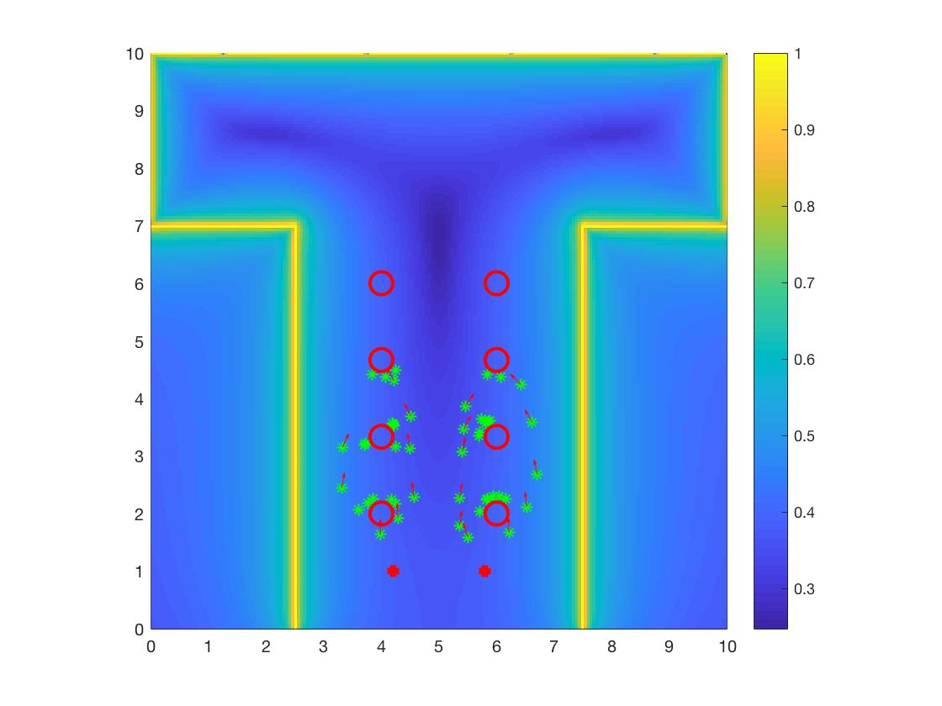
Introduction and Motivation
Number of People
Food Locations
Tables’ Disposition
Affect the behavior of the participants ?
Source: Pix4D
Social Force Model
Notes:
The main objective of the research consists in explaining what was known 20 years ago about piezos,
and this is the first half of the half of the contents of the paper
and the experimental comparison with another solution that was well established, the constrained layer damping treatments
The experiment will be explained by Francesca

Slide 9







Description of the Model
Force due to Destination
Considering a pedestrian alfa:
Force due to other pedestrians
Monotonic decreasing force field with elliptical shape
$${\vec{v}}_{α}^{0}{\vec{e}}_{α}$$
$F_{α}^{0}\left({\vec{v}}_{α},{\vec{v}}_{α}^{0}{\vec{e}}_{α}\right)≔\frac{1}{τ}({\vec{v}}_{α}^{0}{\vec{e}}_{α}$- ${\vec{v}}_{α}$)
$${\vec{v}}_{α}$$
$$F_{α}^{0}$$
Source: Pix4D
$${\vec{v}}_{α}$$
${\vec{f}}_{αβ}≔−w∇_{{\vec{r}}_{αβ }}V_{αβ}[b({\vec{r}}_{αβ }$)]
$$2b≔\sqrt{{\left(\left\|{\vec{r}}_{αβ }\right\|+\left\|{\vec{r}}_{αβ }−v_{β}∆t{\vec{e}}_{β}\right\|\right)}^{2}−{\left(v_{β}∆t\right)}^{2}}$$
with
Notes:
The main objective of the research consists in explaining what was known 20 years ago about piezos,
and this is the first half of the half of the contents of the paper
and the experimental comparison with another solution that was well established, the constrained layer damping treatments
The experiment will be explained by Francesca

Slide 10


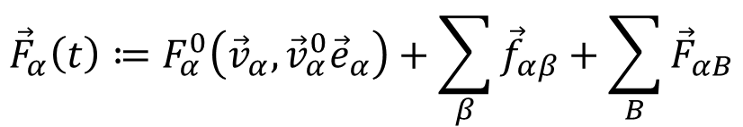

Description of the Model
Force due to obstacles and walls
Monotonically decreasing force field
Total Force
Summation of all forces
$${\vec{r}}_{αB }$$
${\vec{F}}_{αB}≔−∇_{{\vec{r}}_{αB }}U_{αB}(\left\|{\vec{r}}_{αB }\right\|$)
$${\vec{F}}_{αB}$$
Source: Pix4D
$${\vec{F}}_{α}\left(t\right)≔F_{α}^{0}\left({\vec{v}}_{α},{\vec{v}}_{α}^{0}{\vec{e}}_{α}\right)+\sum_{β}{{\vec{f}}_{αβ}}+\sum_{B}{{\vec{F}}_{αB}}$$
Notes:
The main objective of the research consists in explaining what was known 20 years ago about piezos,
and this is the first half of the half of the contents of the paper
and the experimental comparison with another solution that was well established, the constrained layer damping treatments
The experiment will be explained by Francesca

Slide 11

Implementation
Person-Person repulsion
Exponentially decreasing potential
Force multiplied by different coefficients considering the relative position of the people
Table-Person repulsion
The tables are obstacles while the people are directed to the food.
Table-person constant Ct=0.05
$$V_{αβ}^{0}e^{b/σ}$$
Source: Pix4D
Notes:
The main objective of the research consists in explaining what was known 20 years ago about piezos,
and this is the first half of the half of the contents of the paper
and the experimental comparison with another solution that was well established, the constrained layer damping treatments
The experiment will be explained by Francesca

Slide 12
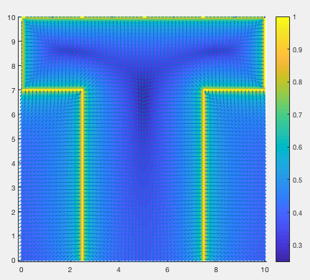
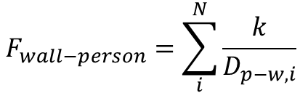
Implementation
Wall-Person repulsion
Total repulsion force is equal to the superposition of all the point source contribution:
Discretization of the Apéro room into a
rectangular mesh of points
$$F_{wall−person}=\sum_{i}^{N}{\frac{k}{D_{p−w,i}}}$$
Source: Pix4D

Slide 13
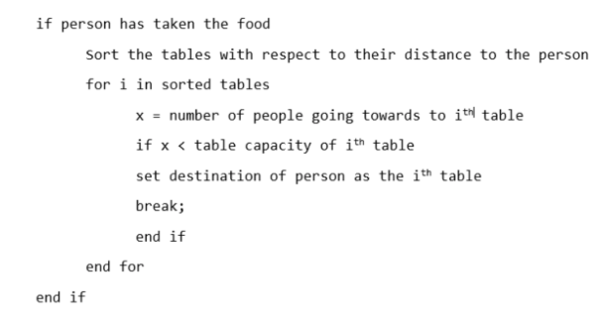
Implementation
Path towards the objective
Pedestrian follows the shortest polygonal route
1st objective: Apéro table
2nd objective: nearest table in the Apéro room
Destination change
Source: Pix4D

Slide 14
Simulation
3 functions are used to consider the cost of every simulations:
Time cost function
Velocity cost function
Force cost function
Simulation conducted by averaging different simulations over 20 attemps each.
The parameters that changed are:
Number of participants
Number of tables
Disposition of tables (circular or rectangular)
Distance between food positions on the buffet table
Source: Pix4D

Slide 15
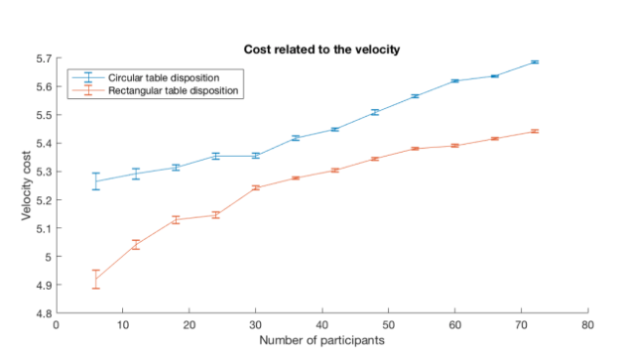
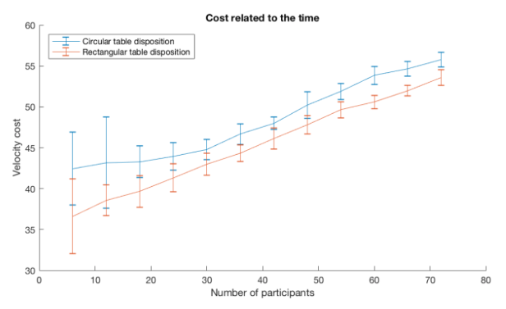
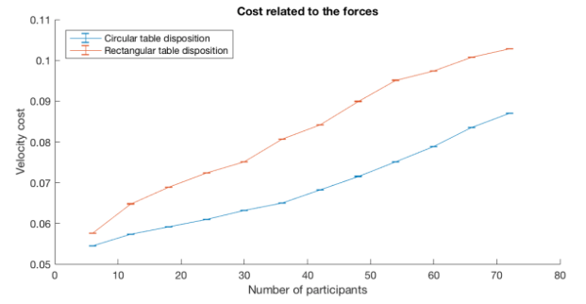
Simulation
Changing the number of participants
Source: Pix4D

Slide 16
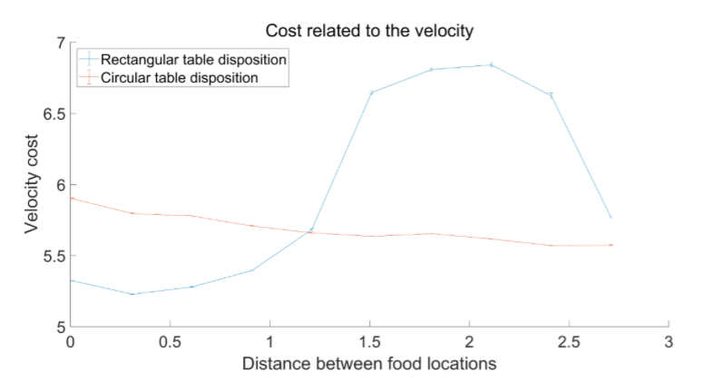
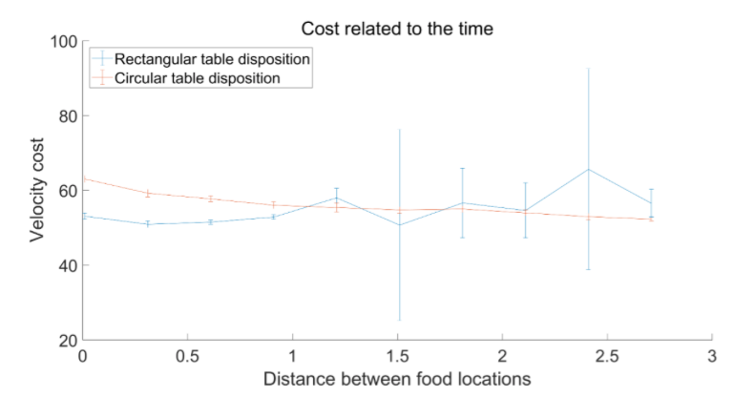
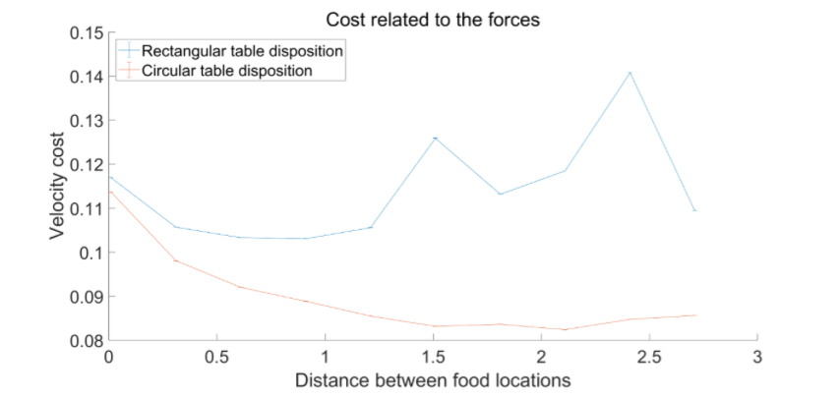
Simulation
Changing the food positions
Source: Pix4D

Slide 17
Summary
Social Force Model
Implementation: person-person, table-person, wall-person, objective destination change.
Cost function increase as number of people increase
Food points separates as far as possible for circle arrangement of table, a bit for rectangular arrangement.
Source: Pix4D

Slide 18
Thank you
Source: Pix4D

